Slide 2
Oracle Code Innovate Hackfest @Motorola
Make.Break.Build
Derrick Cameron, Master Principal Solution Engineer
Aakash Desai, Staff Solution Engineer
Joe Hahn, Cloud Platform Specialist
NA Cloud Solution Engineering - Hub
Feb 21, 2020

Slide 3
Safe harbor statement
The following is intended to outline our general product direction. It is intended for information purposes only, and may not be incorporated into any contract. It is not a commitment to deliver any material, code, or functionality, and should not be relied upon in making purchasing decisions.
The development, release, timing, and pricing of any features or functionality described for Oracle’s products may change and remains at the sole discretion of Oracle Corporation.

Slide 4

My first exercise in exploring the science of outcome probabilities. Use case: simulate a black jack game to determine the dealer advantage.

Slide 5
Decades of R&D…
1983 Doctoral work at MIT genesis of AI company Thinking Machines
1999 Oracle acquires Thinking Machines, including years of IP development
2002 Oracle implements Machine Learning models in the database, and extends support to this day
Next 20 years Oracle expands language, platform, tools, APIs, Application support
Benefits
A platform for everyone: citizen data scientists, career AI professionals, business analysts, anyone who accesses information.
Choice of tools: Oracle Analytic Cloud, SQL Developer, Oracle Data Miner, Day by Day mobile, custom applications.
Choice of language: SQL, Python, Java, Scala, R, Spark …
Choice of Data Store: Database, files, Hadoop, On-premise or cloud, Streaming data, No-SQL Databases,

Slide 6


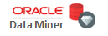

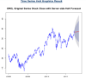
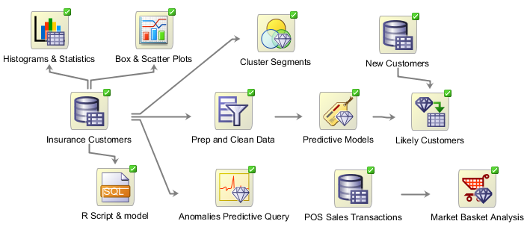
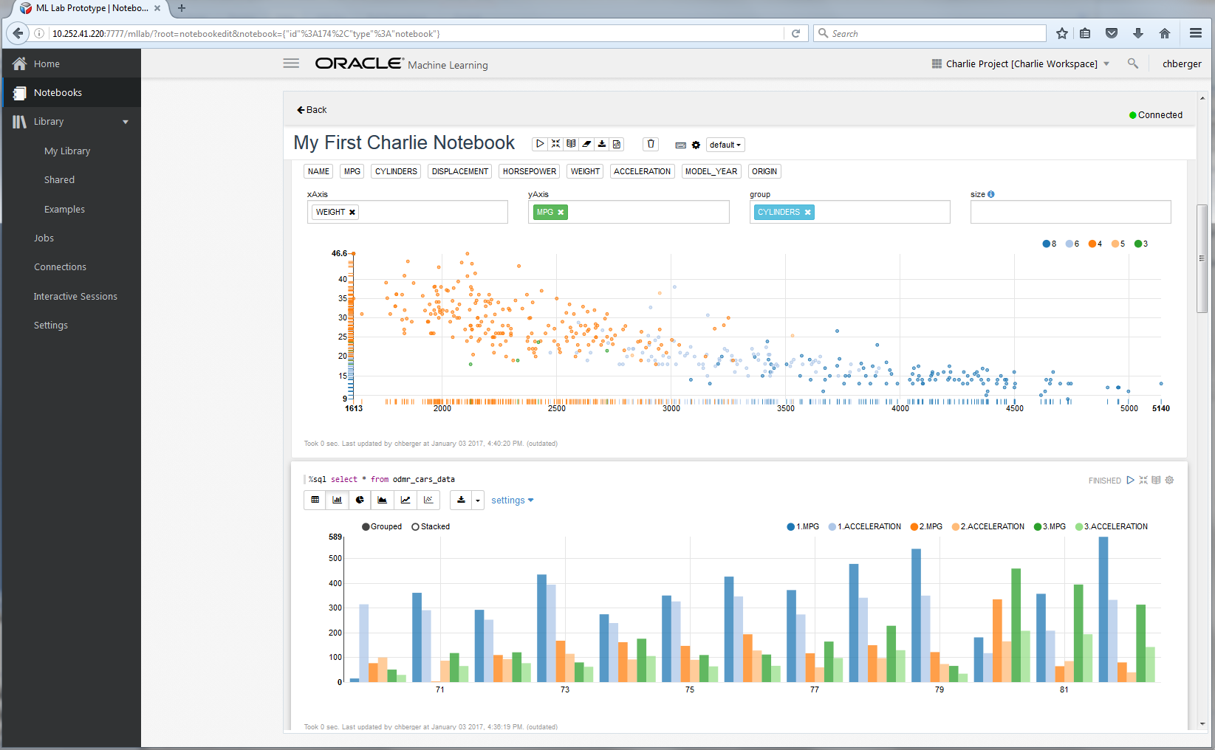
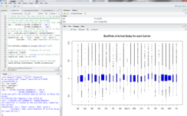
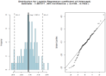
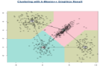
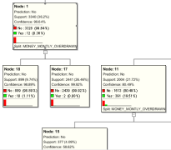
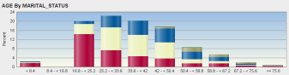
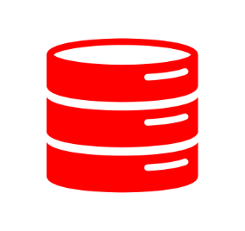
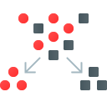

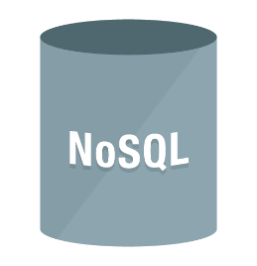




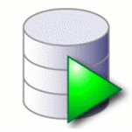

Decades of R&D…
Data Scientists, R Users, Citizen Data Scientists
Architecturally, Many Options and Flexibility
SQL / R / Python
Boil down the Data Lake
Big Data SQL / R
“Engineered Features” – Derived attributes that reflect domain knowledge—key to best models e.g.:
Counts
Totals
Changes over time
Object Store
6

Slide 7
Machine Learning Platforms
Oracle Advanced Analytics
Statistics and Machine Learning Algorithms
Graph Analytics
Spatial Analytics
Oracle Machine Learning for Python (OML4PY)
Oracle Machine Learning for Spark (OML4SPARK)
Big Data: Oracle R Advanced Analytics for Hadoop (ORAAH)
Oracle Analytics Cloud: OBIEE on – premise, Data Visualization Desktop, OAC for the cloud
Oracle Machine Learning for ADW (Zeppelin Notebooks with in-database algorithms)
Stream Analytics
Oracle Data Science:
Jupyter Notebooks
Multi-Language
All the populate data platforms

Slide 8
Oracle Analytics Cloud Service
An analytics platform that empowers business analysts and consumers with modern AI-powered, self-service analytics capabilities for data preparation, visualization, enterprise reporting, augmented analysis, and natural language processing/generation.

Slide 9
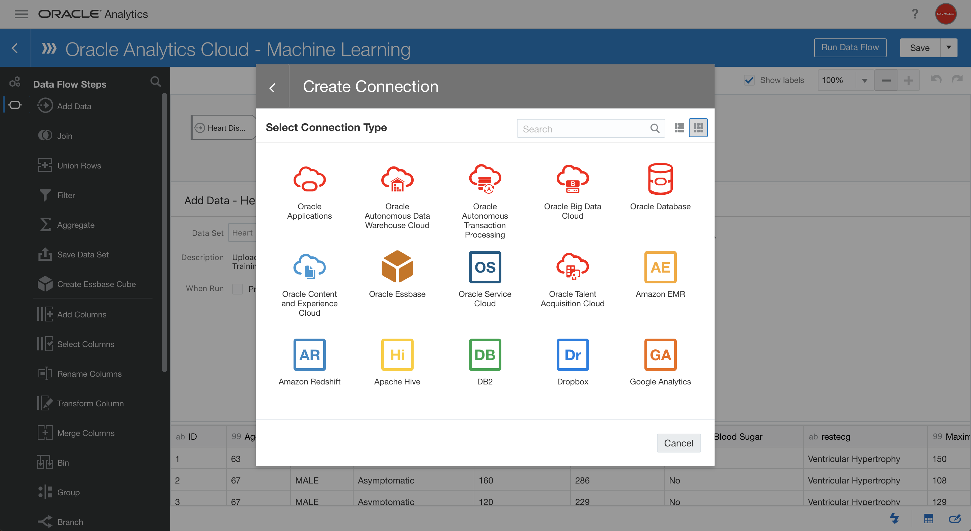

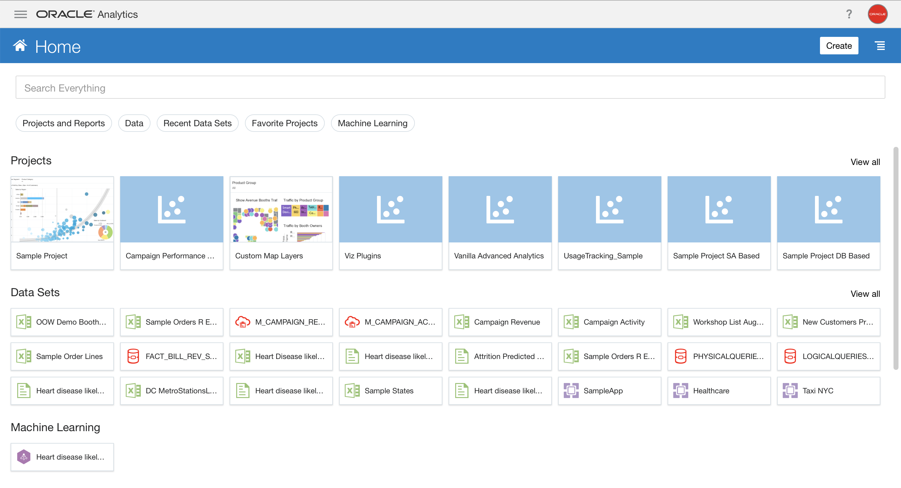

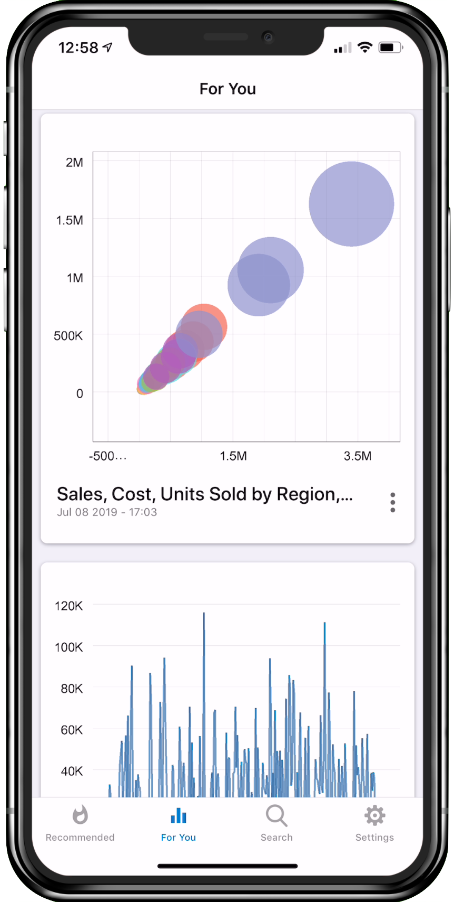

Oracle Analytics Platform
Connect
Integrate
Store
Analyze
Consume
LOB
Real-time connection
Oracle Analytics
Data
Scientists
Data Integration
Autonomous
Data Warehouse
Analysts
Day by day
Developers
Object Storage

Slide 10




Oracle Analytics Platform
Natural language processing and chat bot integrations
Personalized insights and knowledge graphs
Automated and custom machine learning
Deep data profiling and intelligent enrichment
10

Slide 11
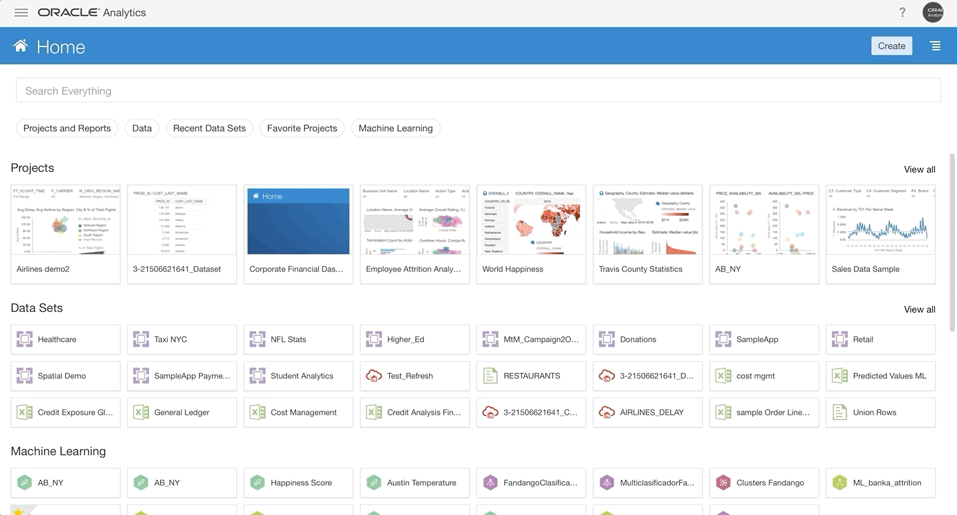
Open connectivity
Fully integrated with Autonomous Database
Connectors to various data sources including: Amazon Redshift, Fusion Apps, EPM Cloud, Microsoft SQL Server, Snowflake, Oracle Database and more!

Slide 12
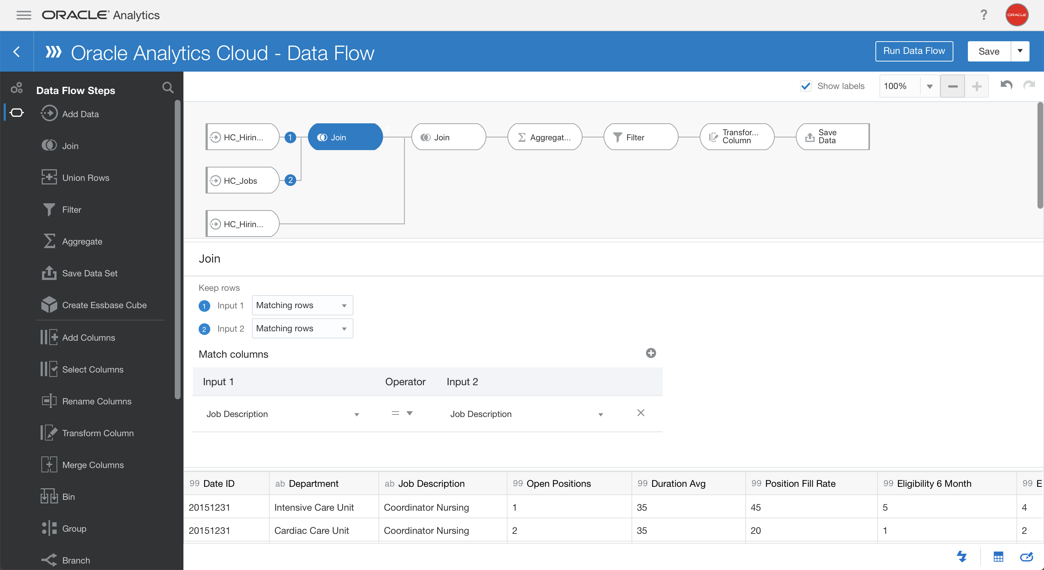
Data flow
Use Data Flow to ingest, clean and transform easily your data from various sources and cloud!
Group, split, join, union, merge and save data into a database or a cube

Slide 13
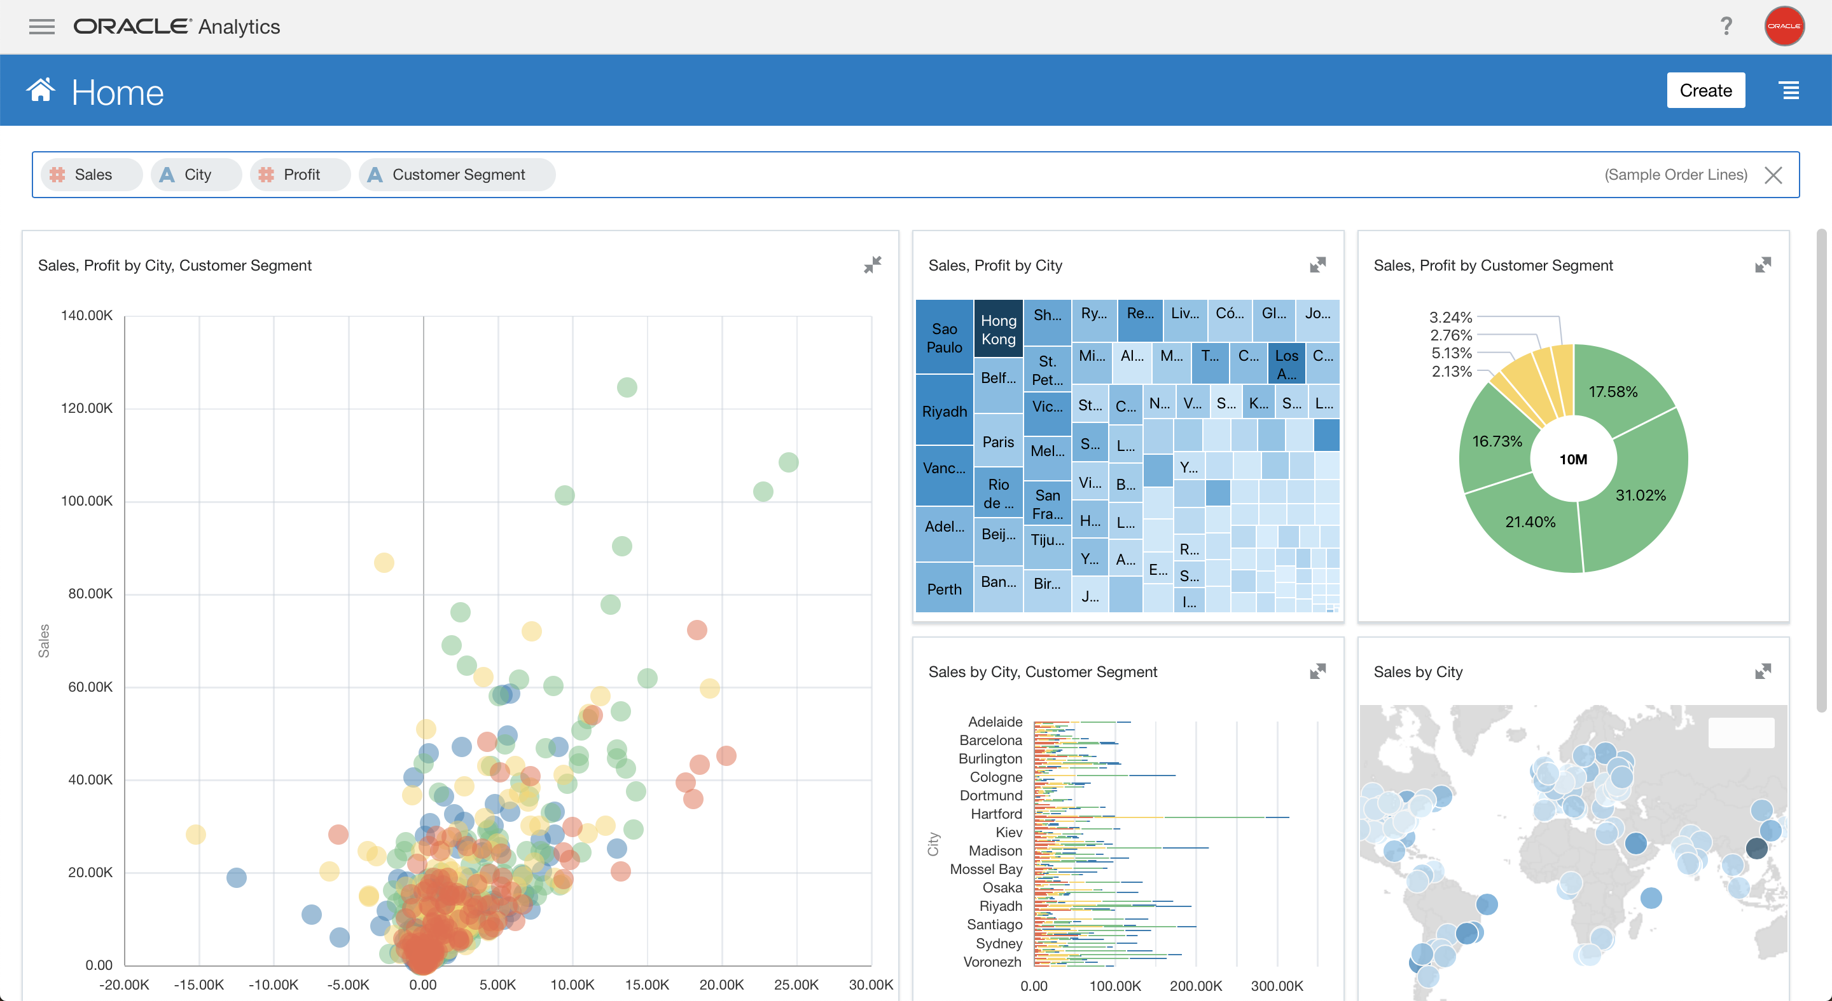
Natural language processing
Query data directly using Natural language processing
No Query or SQL needed
Augmented analytics
Voice enabled

Slide 14
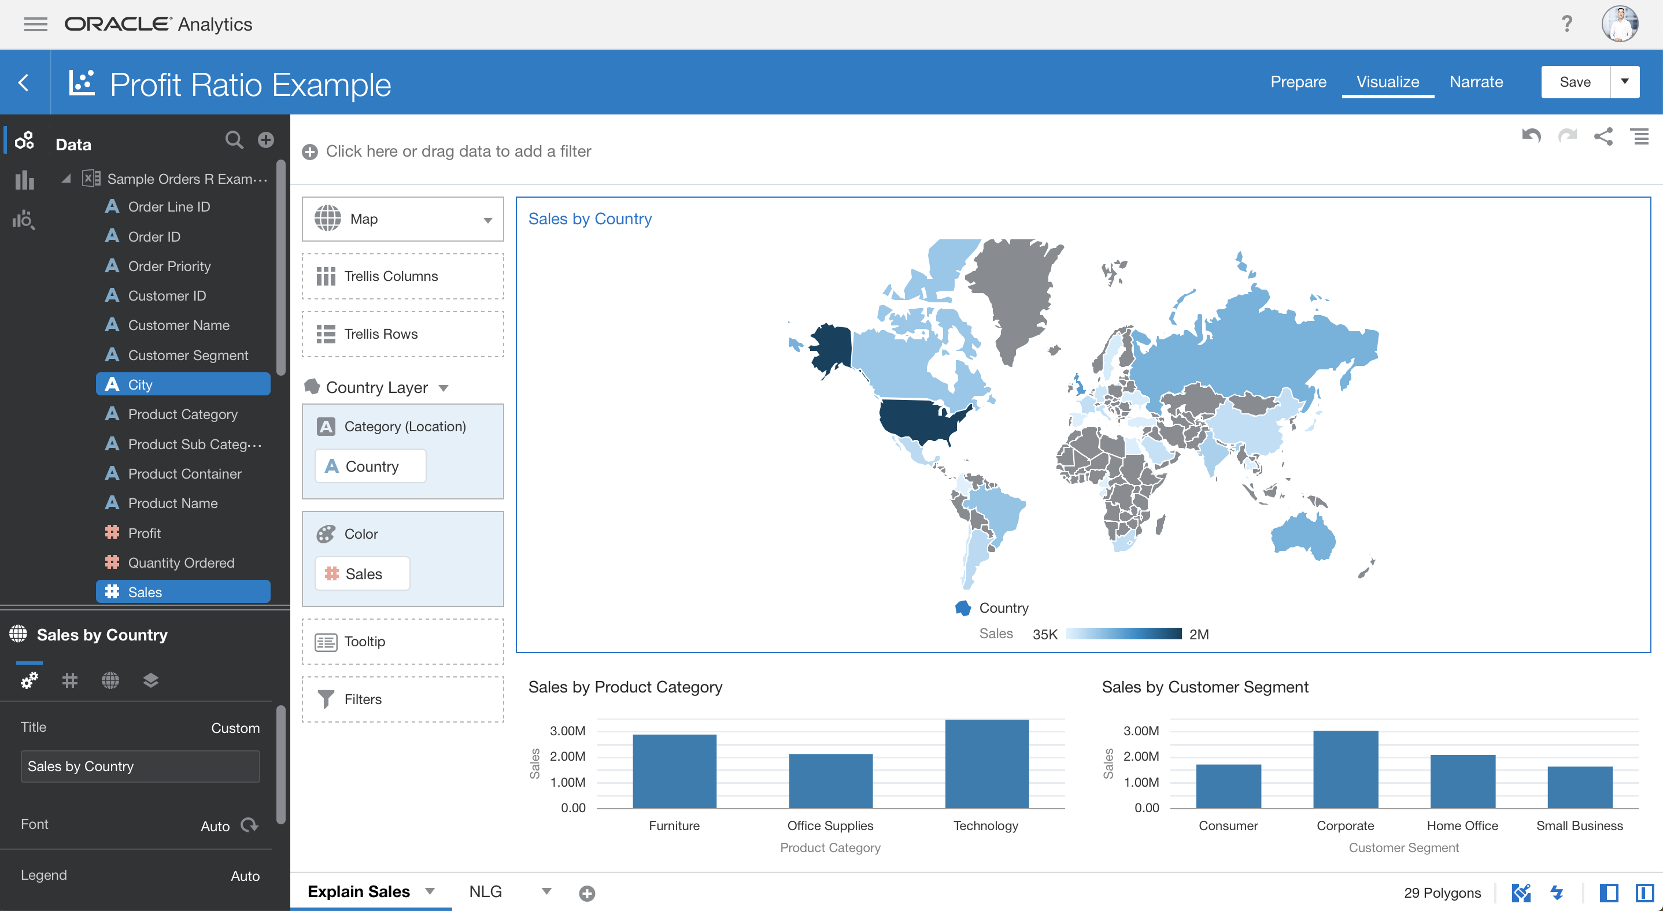
Self-service analytics
Self-service analytics
1-click to forecast for predictive analytics
What-if scenarios
Multiple data sources join
Data story telling

Slide 15
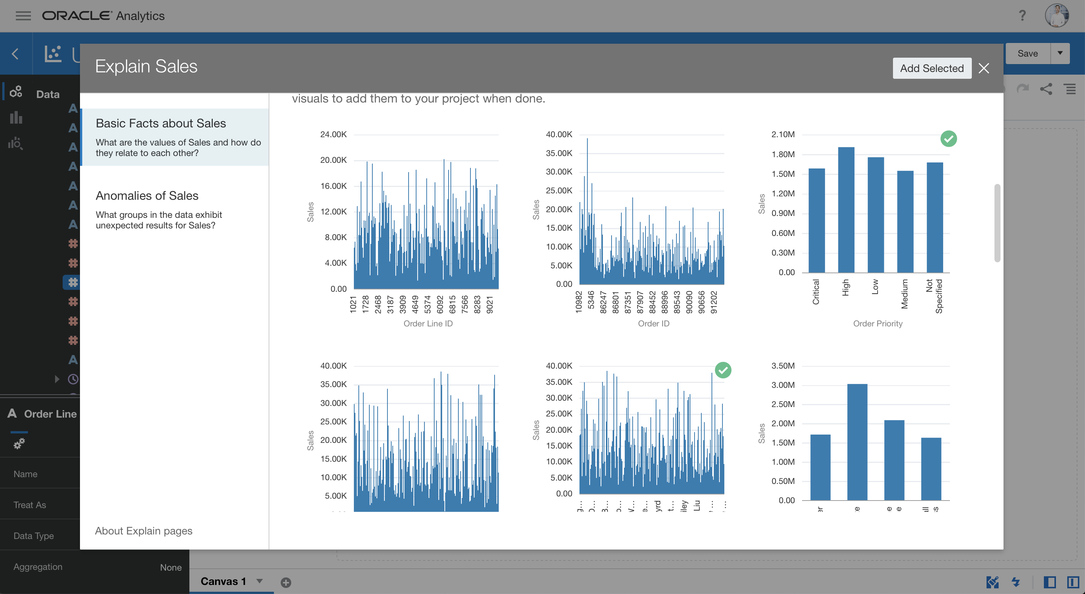
AI data exploration
AI data exploration and insights
Machine Learning models to provide top insights
AI data profiling and data enrichment
One click forecast, clustering and more

Slide 16
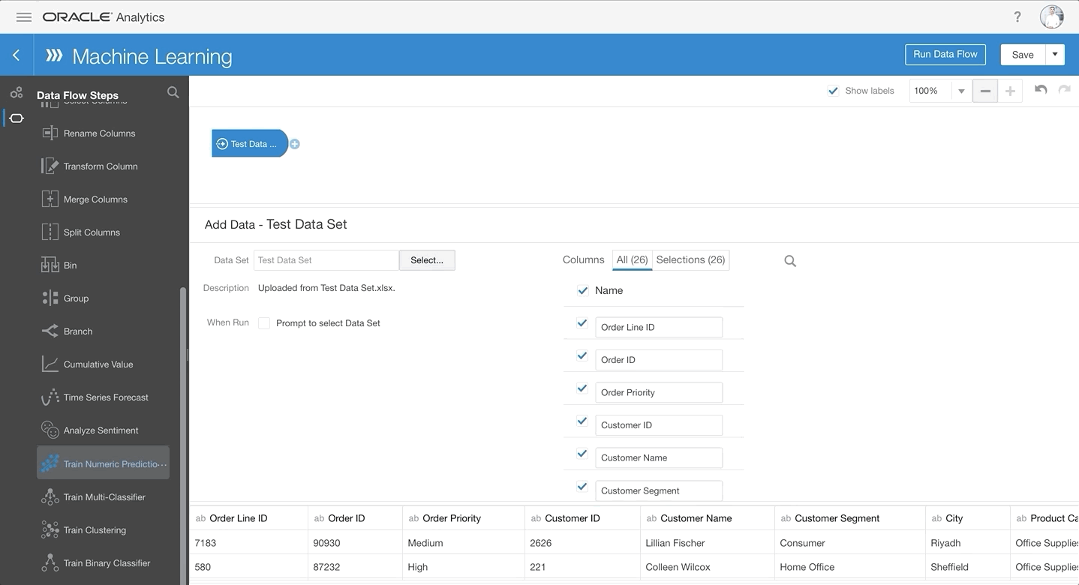
Machine learning
Data flow to train machine learning models
Linear Regression, Random Forest, CART, k-means clustering and more algorithms
Machine Learning models for predictive analytics

Slide 17
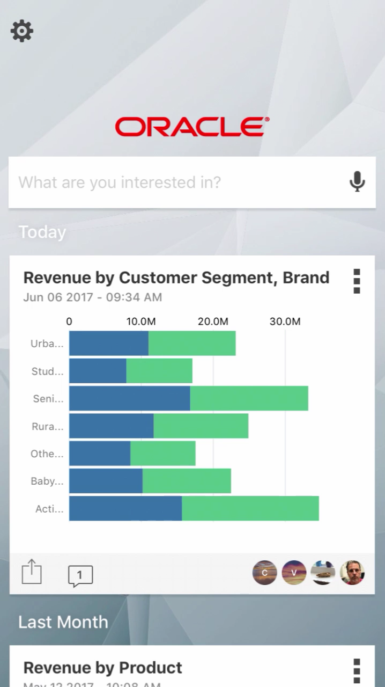

True mobile analytics
True mobile augmented analytics
All data sources available to query
Intelligent recommendations collaborative

Slide 18
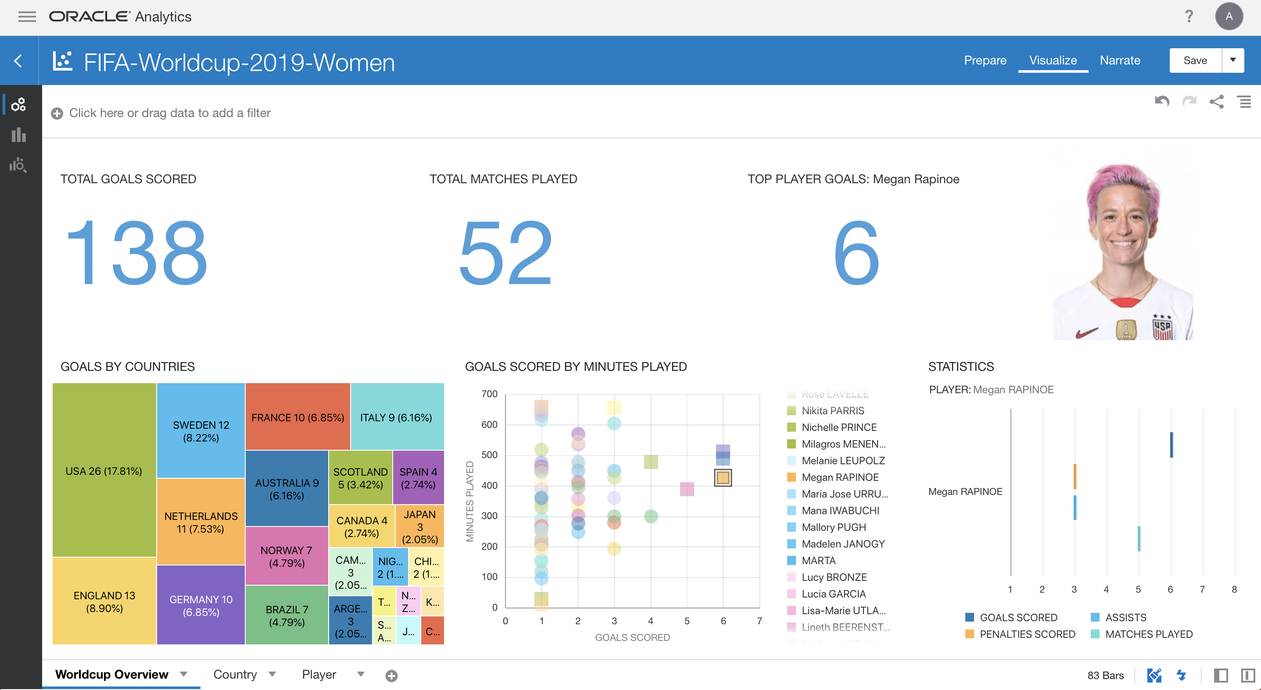

Slide 19
Oracle Machine Learning
A collaborative Zeppelin notebook for Oracle’s machine learning capabilities

Slide 20

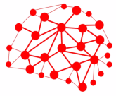
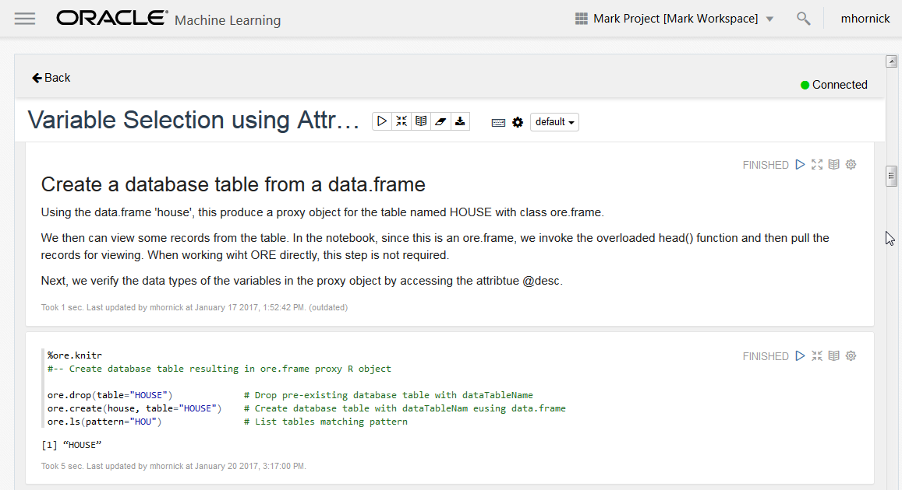
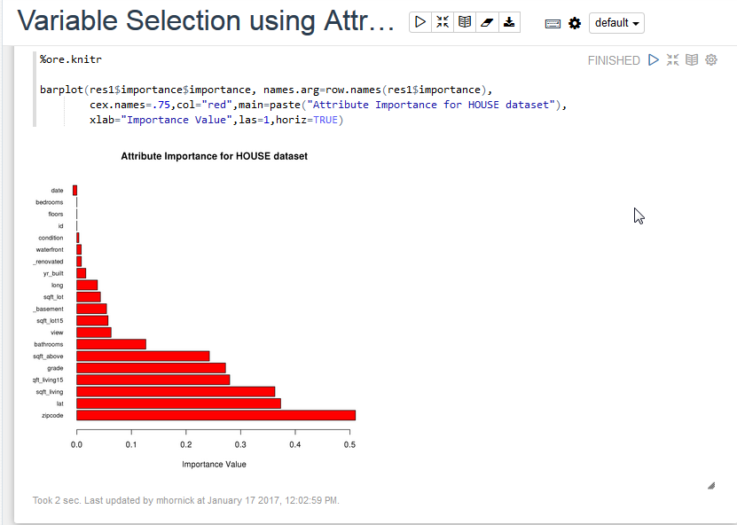
Introduction
A collaborative unified notebook user interface for Oracle’s machine learning capabilities
Enables teams to…
Leverage the languages, platforms and engines of their choice
Explore and prepare data
Build, access, and use machine learning models
Deploy machine learning solutions
20

Slide 21
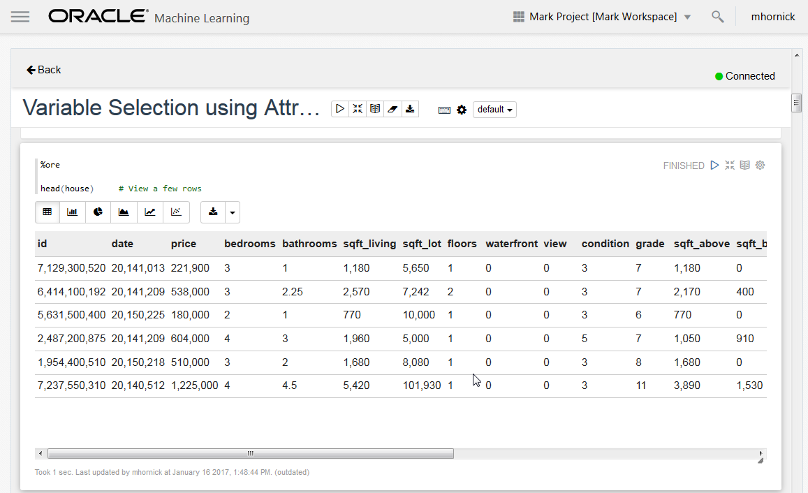
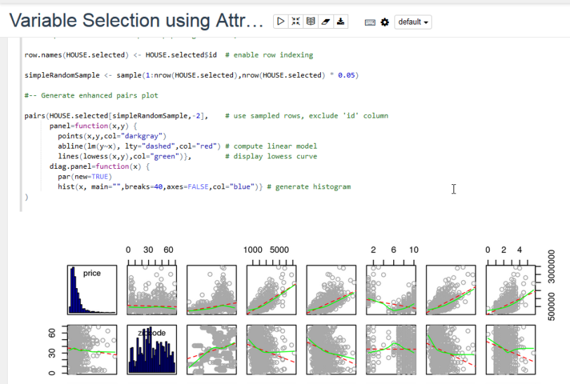
Features
Zeppelin-based Unifying Notebook UI
Multiple backend servers, analytical engines and languages
Oracle and open source algorithms, platforms, tools, and data sources (SQL, R, Spark, Python)
Provides a flexible toolbox for the data scientist
Supports collaborative development
Shared notebooks and templates, with access permissions
Supports deployment of predictive analytics solutions
Enables publishing libraries, templates, examples of common use cases
Dynamic and expandable platform
21

Slide 22

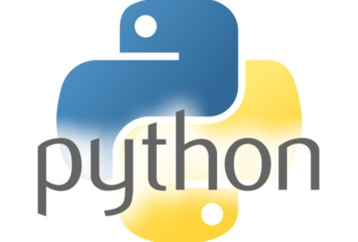
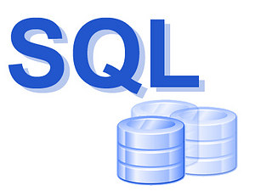


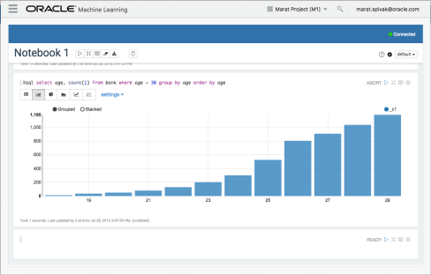
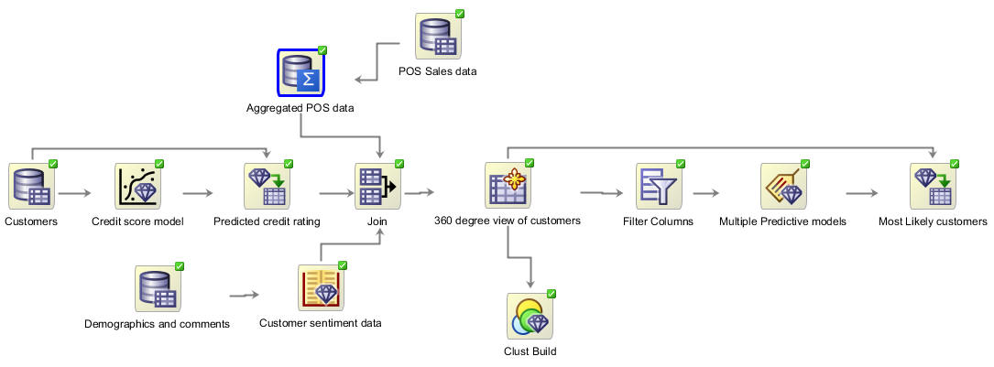
Target Personas
“Coders”
Data Scientists (v1)
R/ORE/ORAAH, SQL/ODM
Python, Scala
Database and Application Developers
SQL and Big Data SQL (v1)
REST API (v2)
“Clickers”
Citizen Data Scientists (v3)
Visual Pipelines / Workflows
Business Users (v2)
Lightweight Notebook Viewers

Slide 23
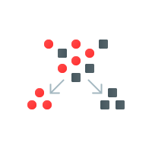
Machine Learning Models
Classification
Logistic Regression
Decision Tree
Random Forest
Neural Network
Support Vector Machine
Naïve Bayes
Explicit Semantic Analysis
Clustering
Hierarchical K-Means
Hierarchical O-Cluster
Expectation Maximization
Anomaly Detection
One-Class Support Vector Machine
Regression
Generalized Linear Model
Support Vector Machine
Random Forest
Linear Model
Stepwise Linear regression
LASSO
Feature Extraction
Non-negative Matrix Factorization
Principal Component Analysis
Singular Value Decomposition
Algorithm Text Support
Tokenization and theme extraction
Document similarity
Algorithms support text type
Association Rules
A priori
Attribute Importance
Minimum Description Length
Principal Component Analysis
Unsupervised Pairwise KL Divergence
Time Series
Single Exponential Smoothing
Double Exponential Smoothing
SQL Predictive Queries
Open Source CRAN R Algorithm Packages through Embedded R Execution
Spark MLlib algorithm integration

Slide 24
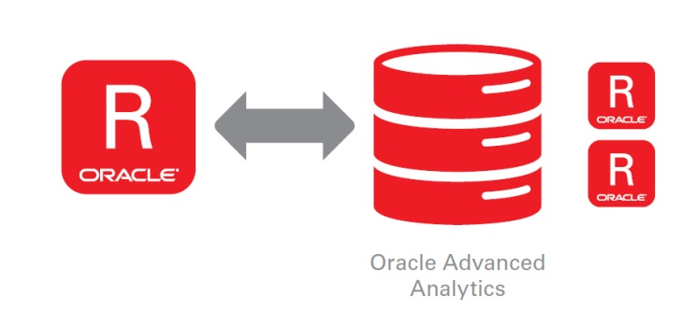
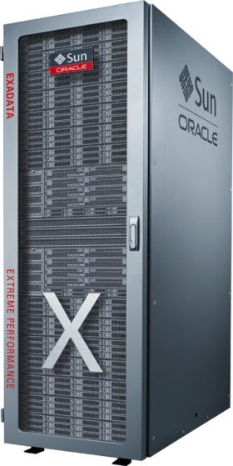
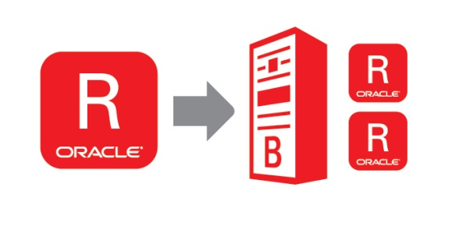

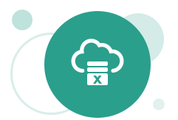


Apache Zeppelin
Support for Oracle-specific and other interpreters
Oracle Database (SQL, PL/SQL, with Oracle Data Mining)
Oracle R Enterprise
Oracle R Advanced Analytics for Hadoop
Oracle Graph Server (PGX)
MySQL
Livy
Workspaces / projects / versioning
Advanced privilege concept for collaboration
Deploy/schedule notebooks
Dynamic startup/shutdown of Zeppelin servers
Zeppelin Docker Management
Spawn Zeppelin Server Instance per user per connection group
Auto shut down
24

Slide 25
Demonstration
Oracle Analytic Services

Slide 26
Thank you
Derrick Cameron
Aakash Desai
Joe Hahn
Oracle Cloud Solution Hub

